Slide 1
Municipal Land Trust Symposium Risk Management Considerations
Ian C. Ridlon, Esq., President and Executive Director
May 3, 2025

Slide 2
Who is “The Trust”?
The Rhode Island Interlocal Risk Management Trust was created in 1986 by the Legislature.
§ 45-5-20.1. Power of city and town councils and regional school districts to jointly establish an insurance corporation, to obtain insurance, and to enter into a cooperative risk management program

Slide 3
The Purpose of The Trust
(1) issuing to the eligible entities policies of insurance and reinsurance of all types and categories, including, without being limited to, the following types and categories: property, casualty, and life, accident, and health insurance, and
(2) developing and administering an interlocal risk management program. The corporations, in addition, may have as their purposes reducing the risk of its members; safety engineering; distributing, sharing, and pooling risks; acquiring excess loss insurance; and processing and defending claims against the members of the corporations

Slide 4
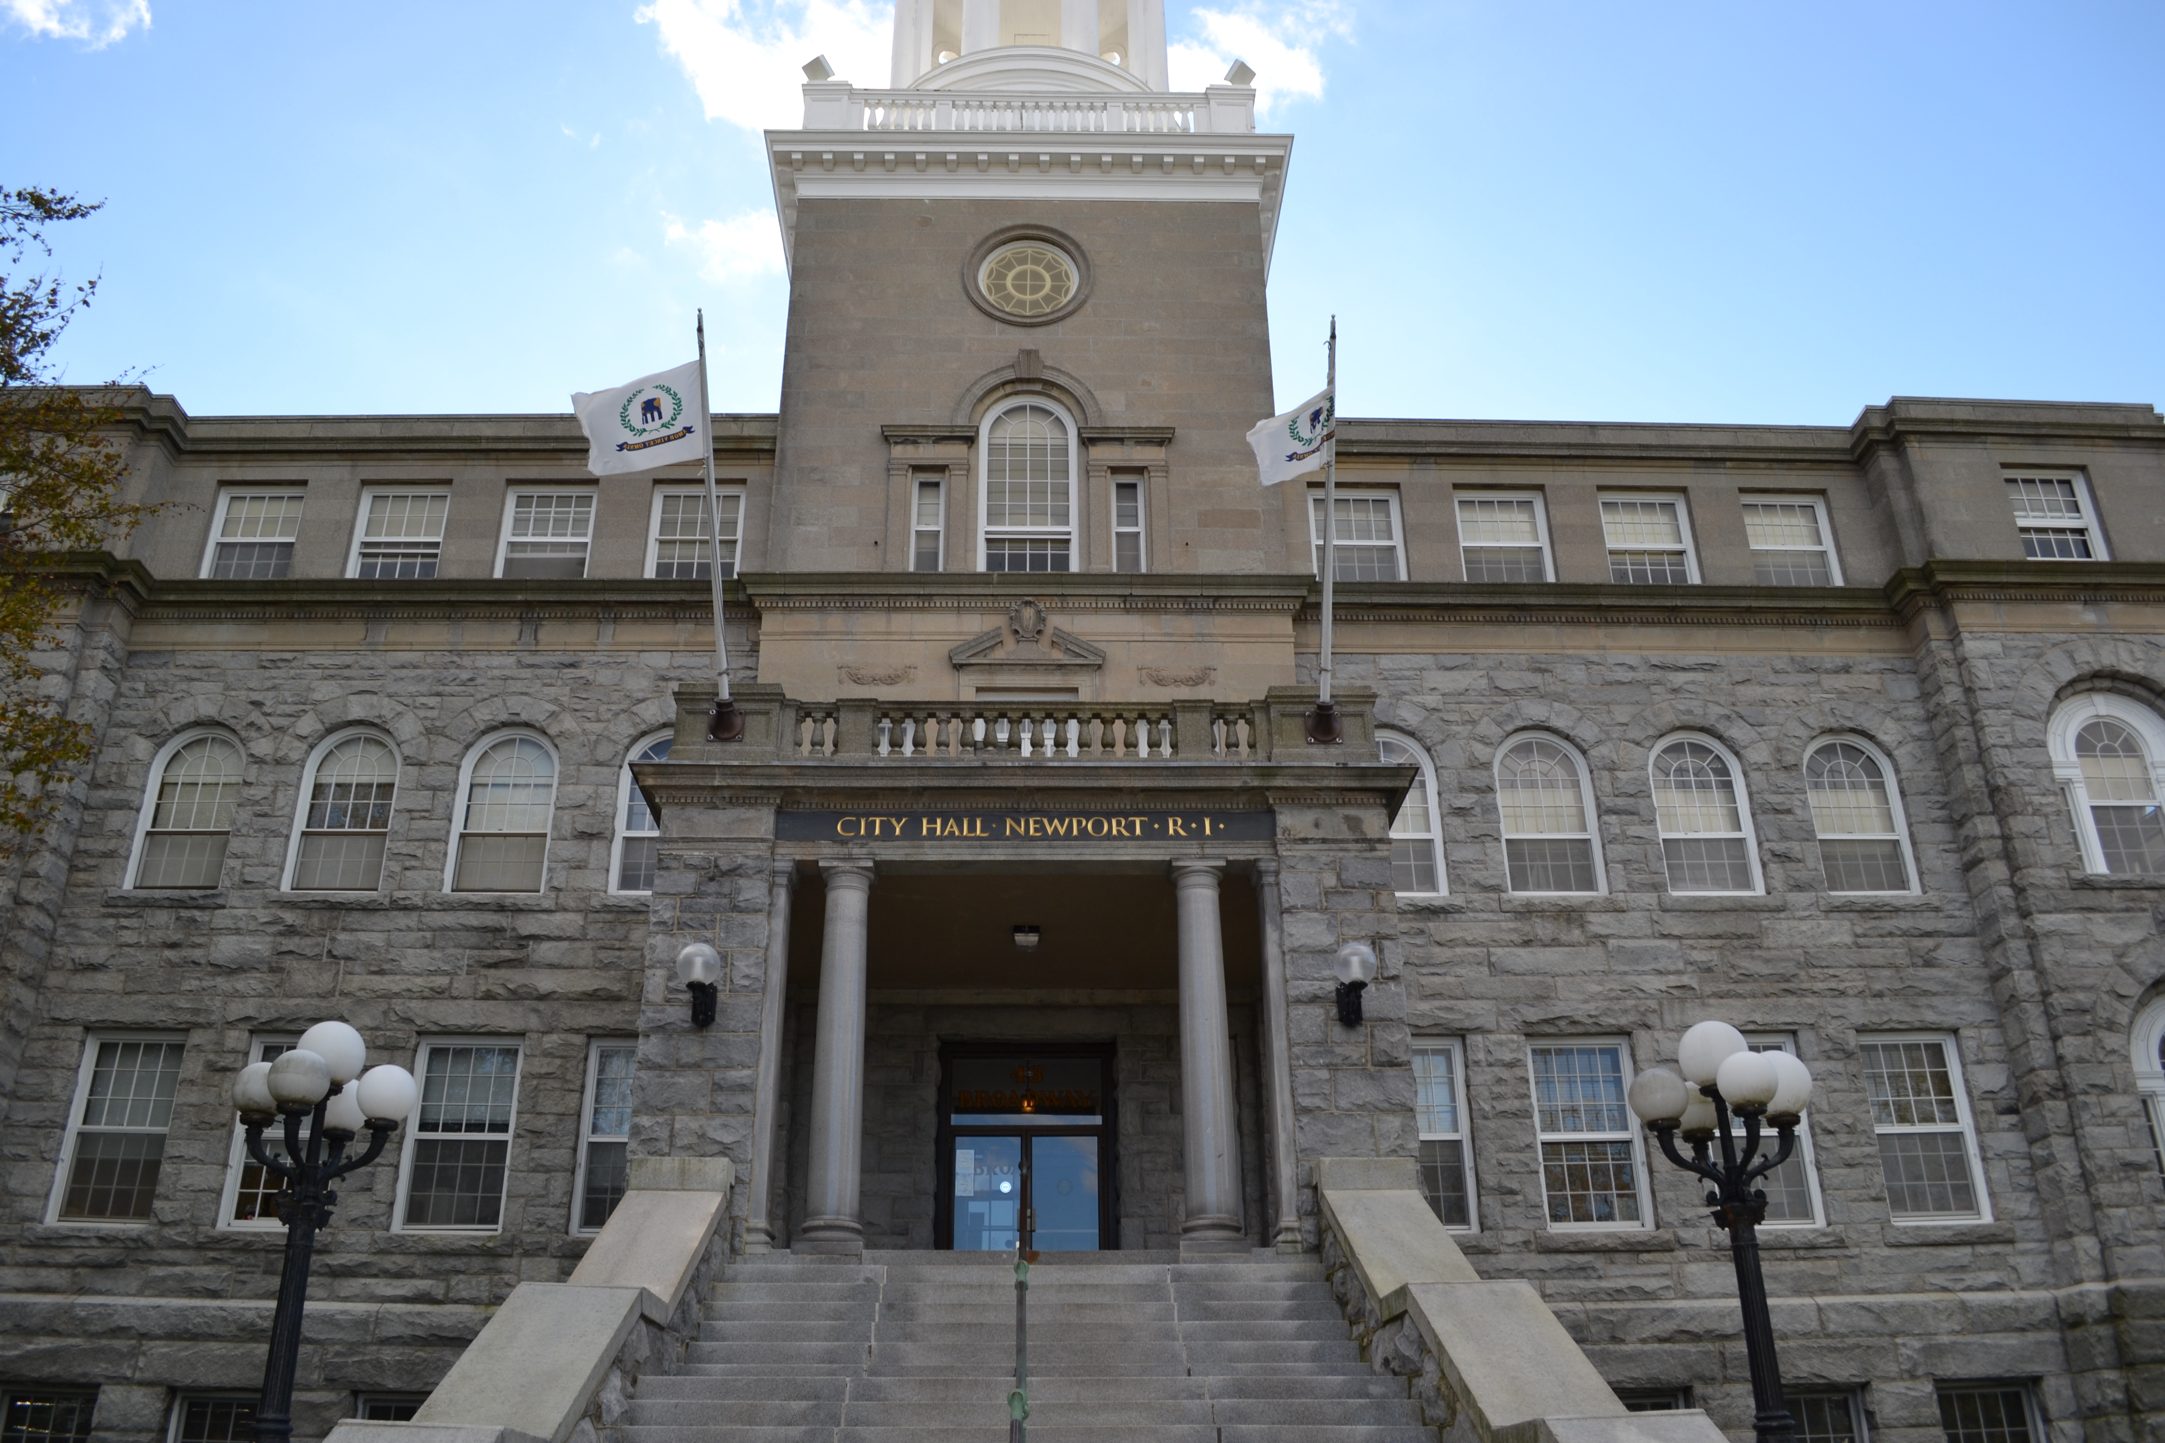
Eligibility
“Eligible Entities” shall mean any city, town, school committee, water or fire district, or other public or quasi-municipal authority, agency or entity, or organization that is an instrumentality of such cities or towns, or any group of such cities or towns, authorities, agencies or entities which is a member of the corporations created pursuant to the provisions of this section.

Slide 5
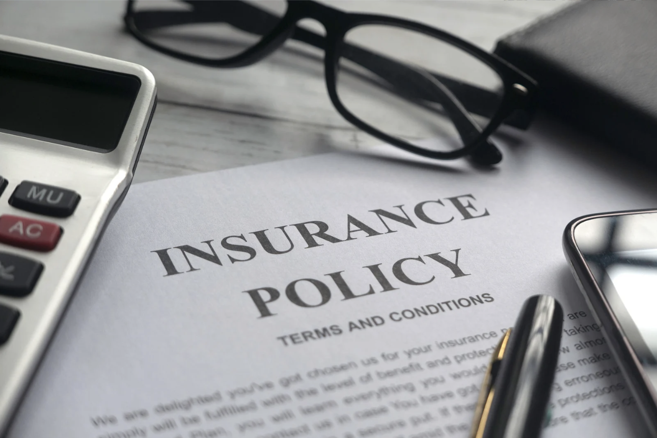
INSURANCE CONSIDERATIONS
The Trust’s Liability Insurance Policy is created, essentially, by the membership, and is uniquely tailored to public sector risks.

Slide 6
GENERAL LIABILITY POLICY
AGREEMENT A - GENERAL LIABILITY: The Trust hereby agrees, subject to the limitations, terms and conditions hereunder mentioned, to pay on behalf of the "Insured Member" for all sums which the "Insured Member" shall be obligated to pay by reason of the liability imposed upon the "Insured Member" by law or assumed by the "Insured Member" under contract or agreement or pursuant to the "Products Completed Operations Hazard", for damages direct or consequential, and expenses, all as more fully defined by the term "Ultimate Net Loss", on account of "bodily injury", including death at any time resulting therefrom, suffered or alleged to have been suffered by any person or persons and/or "property damage" arising out of any "occurrence" happening during the period of Insurance

Slide 7
AGREEMENT E – PUBLIC OFFICIALS’/SCHOOL BOARD LIABILITY
AGREEMENT E - PUBLIC OFFICIALS'/SCHOOL BOARD LEGAL LIABILITY: The Trust hereby agrees, subject to the limitations, terms and conditions hereunder mentioned, to pay on behalf of the "Insured Member" for all sums which the "Insured Member" shall be obligated to pay, all as more fully defined by the term "Ultimate Net Loss", as the result of damages alleged in any claim or claims first made during the period of insurance against them individually or collectively during the period of this Insurance arising out of a "wrongful act"

Slide 8
KEY DEFINITIONS
INSURED MEMBER - The term "Insured Member" includes all persons who were, now or shall be lawfully elected or lawfully appointed officials, trustees, directors, employees, volunteers or council members of the "Insured Member" in the regular service of the "Insured Member" during the existence of this Insurance, and any heir, executor, administrator, assign or legal representative of said persons in the event of their death or incapacity.
Volunteers means all persons acting on or behalf of the "Insured Member" with the specific prior approval or knowledge of a responsible official of the "Insured Member".

Slide 9
KEY DEFINITIONS
RELATED ENTITIES - The term "Related Entities" shall mean units of the municipality which are not regarded by law as corporate bodies separate and distinct from the municipality, but which may nonetheless retain authority pursuant to Federal, State or local law to manage their own affairs independent of the municipality's governing authority.

Slide 10
KEY DEFINITIONS
WRONGFUL ACT - The term "Wrongful Act" wherever used herein shall mean any actual or alleged error or misstatement or misleading statement or act or omission or neglect or breach of duty by an "Insured Member" as a public official or employee of the public entity.

Slide 11
COMMONLY ENCOUNTERED EXCLUSIONS
Although there are a number of Exclusions set forth in the Liability Policy, The Trust generally errs on the side of finding coverage for the Members as long as it does not unfairly and adversely impact the rest of the membership. Following are examples of the most common exclusions that we see.

Slide 12
EXCLUSION 1
WITH REGARD TO ALL FIRST AND THIRD PARTY LIABILITY OF THE INSURED MEMBER, THIS INSURANCE DOES NOT APPLY:
to “bodily injury”, “personal injury” or “property damage” expected or intended from the standpoint of the Insured Member.
(emphasis added)

Slide 13
EXCLUSION 28
The following additional exclusions are applicable to Insuring Agreements A (General Liability), C (Police Professional Liability) and E (Public Officials'/School Board Legal Liability) -
This coverage does not apply to liability:

Slide 14
WHAT IS EXCLUDED…
(a) [liability] brought about or contributed to by fraud, dishonesty or bad faith by an Insured Member, or arising from the willful and knowing violation of any statute, ordinance, regulation, or any state or federal guaranteed right committed by or with the knowledge or consent of any Insured Member; notwithstanding this exclusion of liability, The Trust will defend an Insured Member against such claims which seek money damages, subject to all other limitations of this policy, until and unless a judgment or final adjudication is entered either in a civil case against the Insured Member or in a criminal proceeding against the Insured Member; which judgment or final adjudication establishes the Insured Member's fraud, dishonesty or bad faith or which establishes that the Insured Member either committed or had knowledge of or consented to the willful and knowing violation of any statute, ordinance, regulation, or any state or federal guaranteed right.
The conduct, actions or knowledge of any Insured Member shall not be imputed to any other Insured Member for purposes of applying this Exclusion 28(a).

Slide 15
WHAT IS EXCLUDED…
[liability]
(e) for any loss, costs, civil fine, penalty or expense against any Insured Member arising from any complaint or enforcement action from or before any federal, state or local governmental regulatory agency; notwithstanding this exclusion of liability, The Trust will defend, subject to all other limitations of this policy, an Insured Member for alleged "wrongful act"s of discrimination which are brought against the Insured Member at the State of Rhode Island Commission for Human Rights.

Slide 16
WHAT IS EXCLUDED…
[liability]
(g) for any loss, cost or expenses relating to claims, demands or actions seeking relief in any form other than money damages;

Slide 17
WHO IS MY LAWYER?
If a portion of the claim is covered, counsel is appointed to represent the Entity, as well as the officials and/or employees named in their official capacities for the covered counts only. The City or Town Solicitor will generally represent the entity and officials and/or employees relative to the remaining uncovered counts.

Slide 18
WHO IS MY LAWYER?
If an official and/or an employee is named in his or her official and individual capacity, defense counsel may be provided by the city or town. The attorney appointed by The Trust to represent those persons in their official capacities does not necessarily represent them in their individual capacities.

Slide 19
WHO IS MY LAWYER?
If there is the potential for a conflict of interest between the city or town and the official and/or employee in a covered matter, The Trust will appoint separate counsel to ensure that the interests of all “Insured Members” are protected

Slide 20
YOUR WORK IS IMPORTANT!
Public officials' liability coverage is intended, at its heart, to make sure that good people continue to undertake the important public sector service.
Don’t let the threat of unwarranted liability deter you from continuing to do the good work that you do!

Slide 21
STATUTORY PROTECTION
Recreational Use Statute:
§ 32-6-1. Purpose of chapter
The purpose of this chapter is to encourage owners of land to make land and water areas available to the public for recreational purposes by limiting their liability to persons entering thereon for those purposes.

Slide 22
RECREATIONAL USE STATUTE (CONT.)
§ 32-6-3. Liability of landowner
Except as specifically recognized by or provided in § 32-6-5, an owner of land who either directly or indirectly invites or permits without charge any person to use that property for recreational purposes does not thereby:
(1) Extend any assurance that the premises are safe for any purpose;
(2) Confer upon that person the legal status of an invitee or licensee to whom a duty of care is owed; nor
(3) Assume responsibility for or incur liability for any injury to any person or property caused by an act of omission of that person.

Slide 23
RECREATIONAL USE STATUTE (CONT.)
§ 32-6-2. Definitions
As used in this chapter:
(1) "Charge" means the admission price or fee asked in return for invitation or permission to enter or go upon the land;
(2) "Land" means land, roads, water, watercourses, private ways and buildings, structures, and machinery or equipment when attached to the realty;
(3) "Owner" means the private owner possessor of a fee interest, or tenant, lessee, occupant, or person in control of the premises including the state and municipalities;
(4) "Recreational purposes" includes, but is not limited to, any of the following, or any combination thereof: hunting, fishing, swimming, boating, camping, picnicking, hiking, horseback riding, bicycling, pleasure driving, nature study, water skiing, water sports, viewing or enjoying historical, archaeological, scenic, or scientific sites, and all other recreational purposes contemplated by this chapter; and
(5) "User" means any person using land for recreational purposes.

Slide 24
PUBLIC DUTY DOCTRINE
The public duty doctrine is a rule which provides that in order for an injured person to recover in tort against a public entity or an officer or employee thereof, he must show the breach of a duty owed to him as an individual and not merely the breach of a duty owed to the public as a whole.

Slide 25
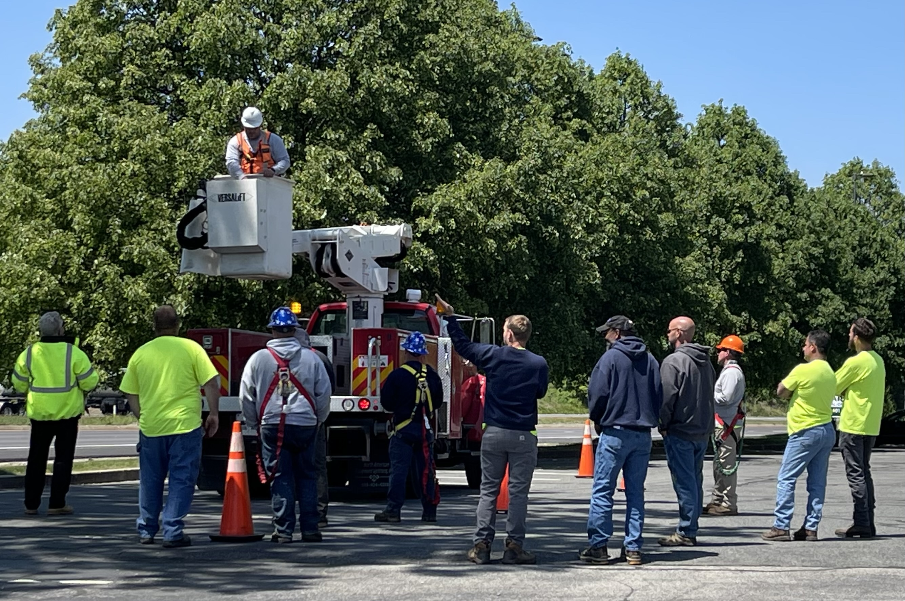
Risk Management
Aquatic & Life Safety Operations Program
Employment Practices (HR) Program
Fortify HR Program
GatherGaurd Special Event Insurance
Property Inspection & Appraisal Program
Emergency Action Plan Development
HR Employment Actions Hotline
Model Policy Development
Occupational Safety & Health
Incident/Claim Reviews
Safety and Loss Prevention Walk-throughs
Work Site Safety Audits and Inspections
Bloodborne Pathogen & HazCom Training
De-Escalation & Communication Skills Training
CPR/AED & First Aid Training
Chainsaw & Chipper Safety Training

Slide 26
Grants and Scholarships
Life & Safety Emergency Action Grants
Safety & Risk Management Scholarship Program
Safety Enhancement Grant Program

Slide 27
QUESTIONS

