Slide 1
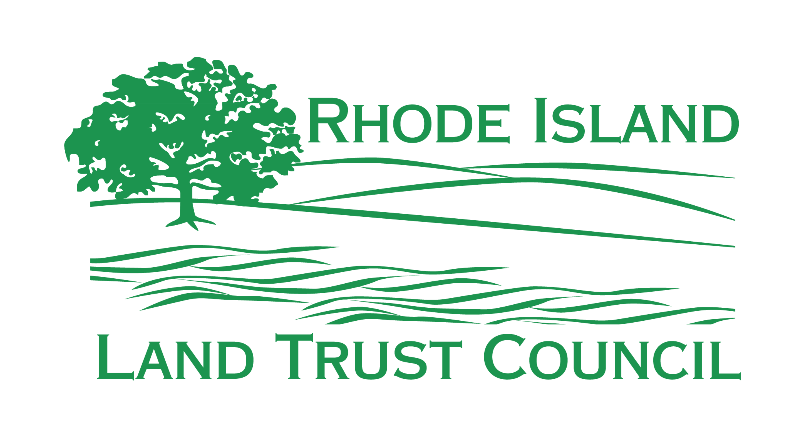
Public Trust Protections for Municipal Conservation Lands – A Refresher
Municipal Land Trust Symposium
May 5, 2025
Tom Rogers, RILTC & formerly Narragansett Land Trust

Slide 2
The Risk: City or Town Conservation Land May Not Necessarily Be Conserved Forever
Cities and Towns generally acquire properties which are either:
Protected by 3rd party Conservation Easements held by RIDEM, et al.
In fee purchases with state or federal funds
In fee purchases by private entities such as the Trust for Public Lands
Likely NOT protected by 3rd party Conservation Easements
In-fee purchases by local referendum
Donations
The Risk: Without a 3rd party conservation easement, the property may be only three town council votes or a city council vote away from disaster even if acquired with the intent of being perpetually conserved

Slide 3
This is NOT a Theoretical Risk
In 2018, HR7425, An Act Relating to the Smithfield Land Trust, was submitted to disband the chartered Trust and transfer all of its properties to the Town Council
The bill was defeated, but the effort sent a resounding message to the Land Trust Community
Perpetual protection of conserved properties became a legislative priority for the RI Land Trust Council

Slide 4
The Solution: General Assembly Session 2021
After several years of work by the RILTC, the General Assembly passed R.I.G.L Title 45, Chapter 36.1, Municipal Public Trust Dedication - Enacted July 3, 2021
Legislative purpose: To provide a voluntary mechanism for cities and towns to dedicate public trust land in perpetuity to ensure preservation of the natural environment
Power to declare: Cities and town may formally dedicate any conservation property as a public trust land to be perpetually protected from conversion to another use
Process to declare: Cities and towns may formally dedicate as a public trust land through a approved resolution of a city or town council. The resolution is recorded in the land evidence records
Restrictions: The land shall be perpetually protected from conversion to a use other than the use for which it was originally obtained. Acceptable uses shall be those that perpetually outdoor recreation, open space, and natural resource conservation.

Slide 5
But What is the Public Trust?
Public Trust Doctrine: With roots in English common law, the colony’s 1663 charter, and the RI Constitution → some resources are so important the we entrust them to the government to maintain for the people.
In Rhode Island, public trust is typically related to coastal and estuarine resources – until now, not used for conservation land
Rhode Island is now only the 2nd state in the Union to have this protection of conservation land - after Pennsylvania

Slide 6
Successes to-date
City or Town | Acres | Date Protected | Comments
Narragansett | 135 | March 21, 2022 | 40 parcels
Warwick | 63 10 | December 19, 2022 November 21, 2023 | Dawley Farm Chepiwanoxet Point
North Smithfield | 70 | June 5, 2023 | Cedar Swamp Conservation Area
Smithfield | 800 | October 2, 2023 | 23 parcels
Several towns in preparation
Your City or Town Next?
Total | 1,078

Slide 7
The Process
Compile the list of municipally-owned conservation parcels to protect
Discuss goals and direction with City or Town staff, Council, et al.
Refine the list
Research parcels in Land Evidence Records and comprehensive plans
Acquire copy of document conveying ownership to the City or Town
Check with Town or City Planner for property not acquired for conservation, such as for affordable housing
Remove those parcels with existing conservation easements
Compile legal descriptions for parcels to protect (“Metes & bounds”)
Prepare the Town or City Council Resolution with attached legal descriptions
Obtain Town or City Council approval of the Resolution
Record the Resolution in Land Evidence Records
Update tax assessor website for each parcel with recorded book and page

Slide 8
In Summary
Cities and Towns now have the means to perpetually protect municipally-owned conservation land:
Public Trust Declarations under R.I.G.L 45-36.1-1
This protection can be accomplished through a city or town council resolution which is then recorded in the city or town’s land evidence records
This protection should not be added on top of existing conservation easements
Do not want conflicting documents
Existing conservation easement are likely adequate
The RILTC is here to help!

