Slide 1
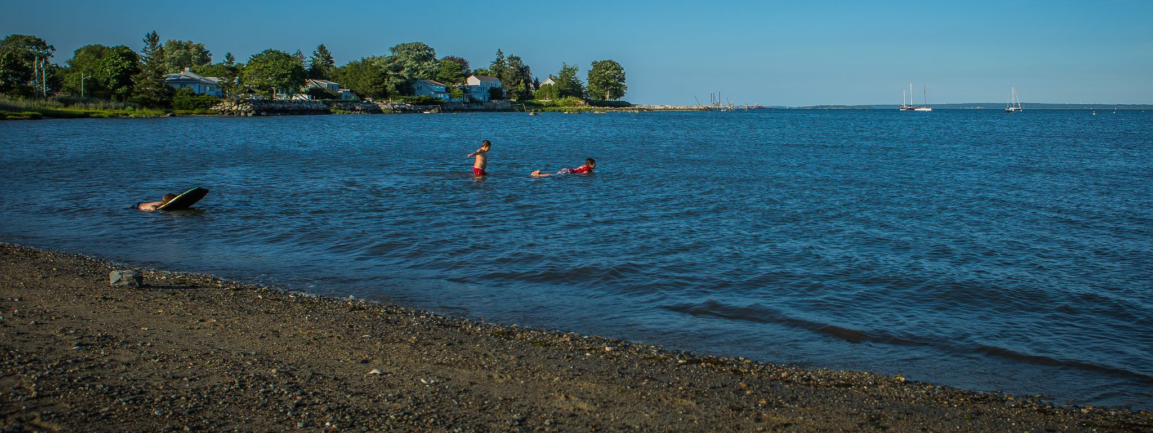
WQDASHBOARD
MAKING WATER QUALITY DATA ACCESSIBLE TO THE PUBLIC
Photo by Ayla Fox
Mariel Sorlien
Alicia Schaffner
Heather Parry

Slide 2
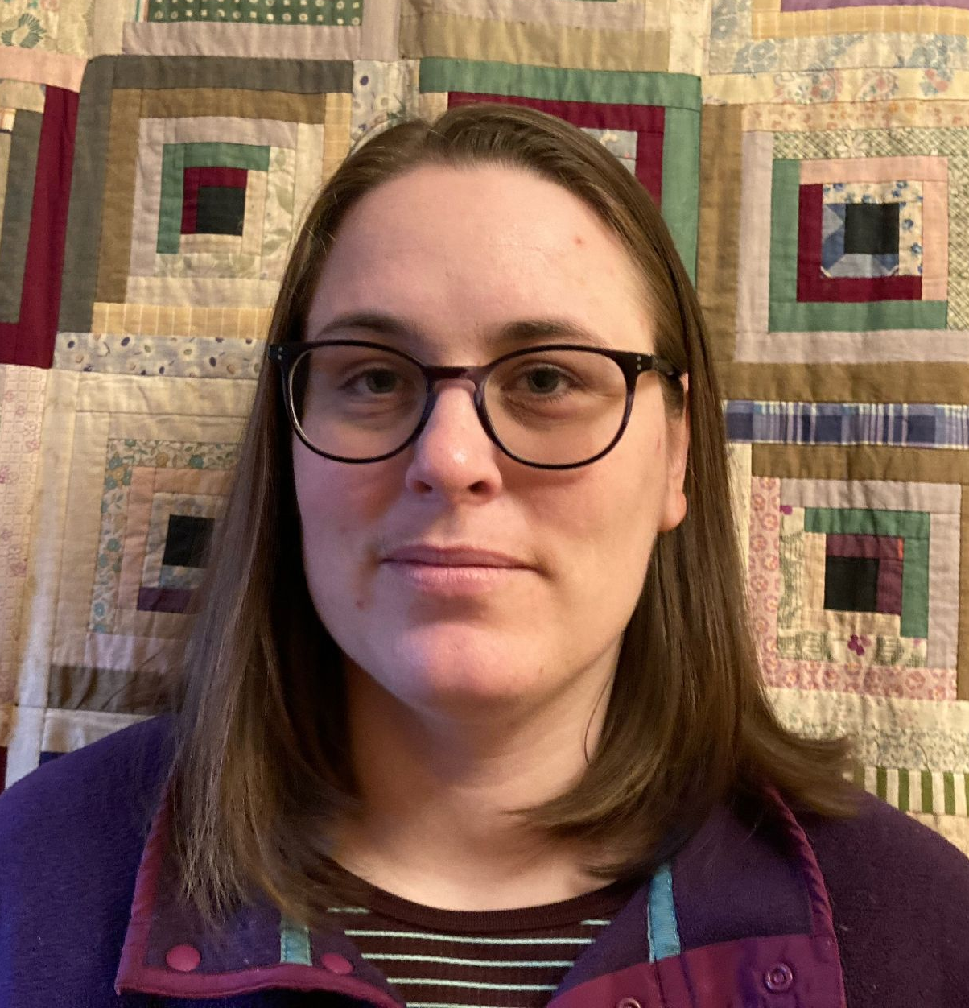
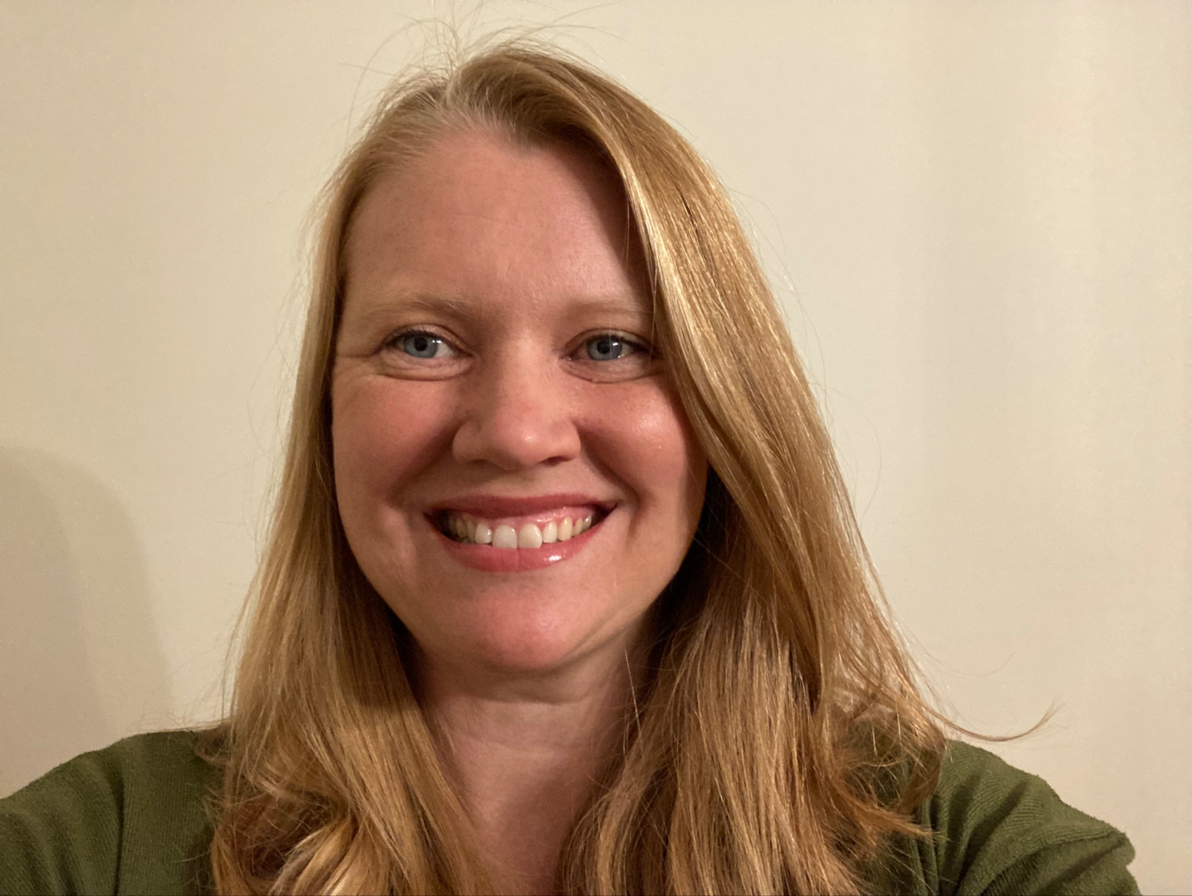
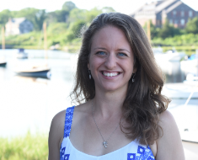



PRESENTERS
Mariel Sorlien
Geospatial and Design Manager
Narragansett Bay Estuary Program
Heather Parry
Executive Director,
Water Quality Program Coordinator
Blackstone River Coalition
Alicia Schaffner
Executive Director
Salt Ponds Coalition
Notes:
Feel free to change anything that I added. I could not find a photo that would scale to the exact dimensions of you photo. We can try resizing my photo. -Heather

Slide 3
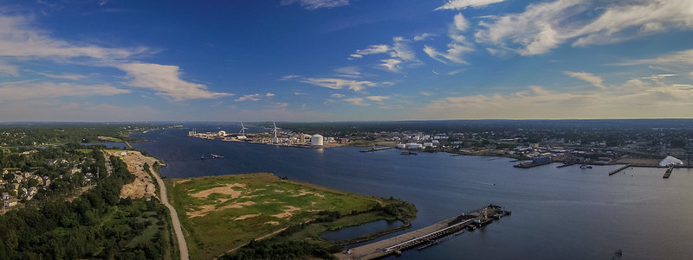
PROJECT BACKGROUND
Photo by Ayla Fox

Slide 4
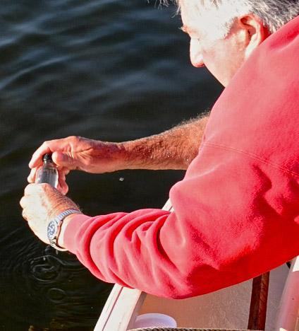
THE PROBLEM
Salt Ponds Coalition has been collecting data for over 40 years.
Currently have 28 sites spread across 6 salt ponds.
SPC utilizes its data for many things including advocacy, long-term monitoring of the ponds and different projects, and educating the public about the health of the ponds.
Every year, we test for nearly ten different factors including DO, nutrients, bacteria, pH, temperature, salinity, Chl-A concentration, and water clarity.
This leads to….

Slide 5
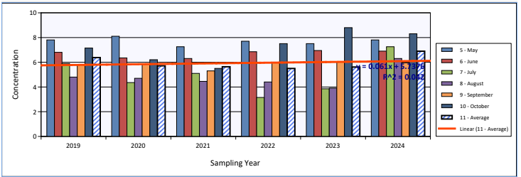
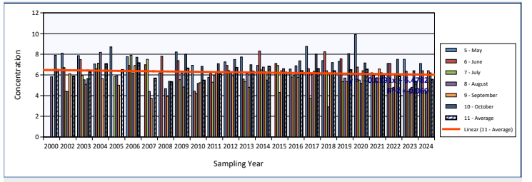
THE PROBLEM 2
… a copious amount of data points over time.
Currently – graphs are static and in some cases nearly unreadable with too much data.
It is difficult to compare different factors, different sites or even different ponds.
Our data is the backbone of what we advocate for, need to be able to present it in a clear, understandable manner.
Make it more accessible to our members and the public.
No expertise within our organization to build/code a dashboard.

Slide 6
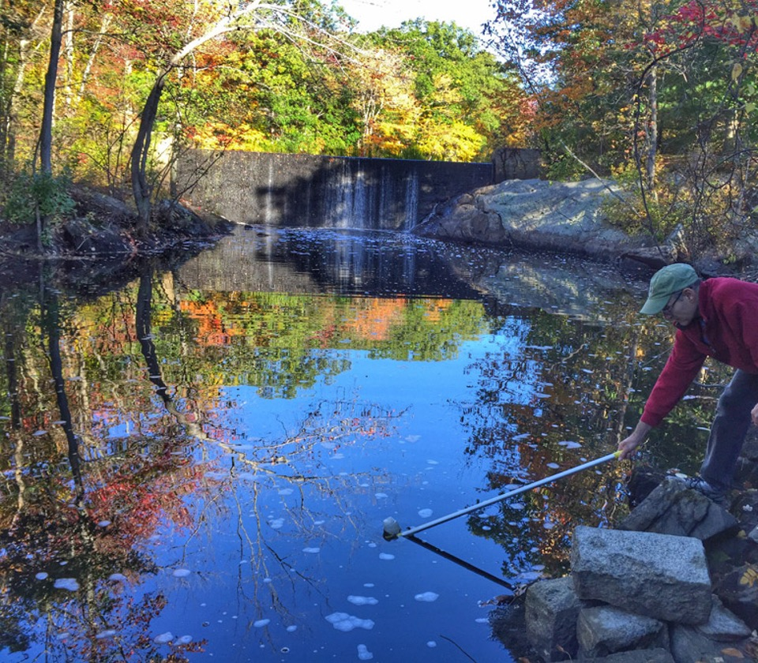
INITIAL SOLUTION: BRCMAP
Water Quality Monitoring Program
Mass DEP approved QAPP
80 volunteers
75 sites throughout watershed
3 volunteer run labs
Sampling on second Saturday of the month April- November
Parameters monitored
Dissolved Oxygen
Temperature
Nitrates
Orthophosphates
Conductivity
Turbidity
E.coli
Notes:
Overview of BRC Program: Volunteer Picture (West River)

Slide 7
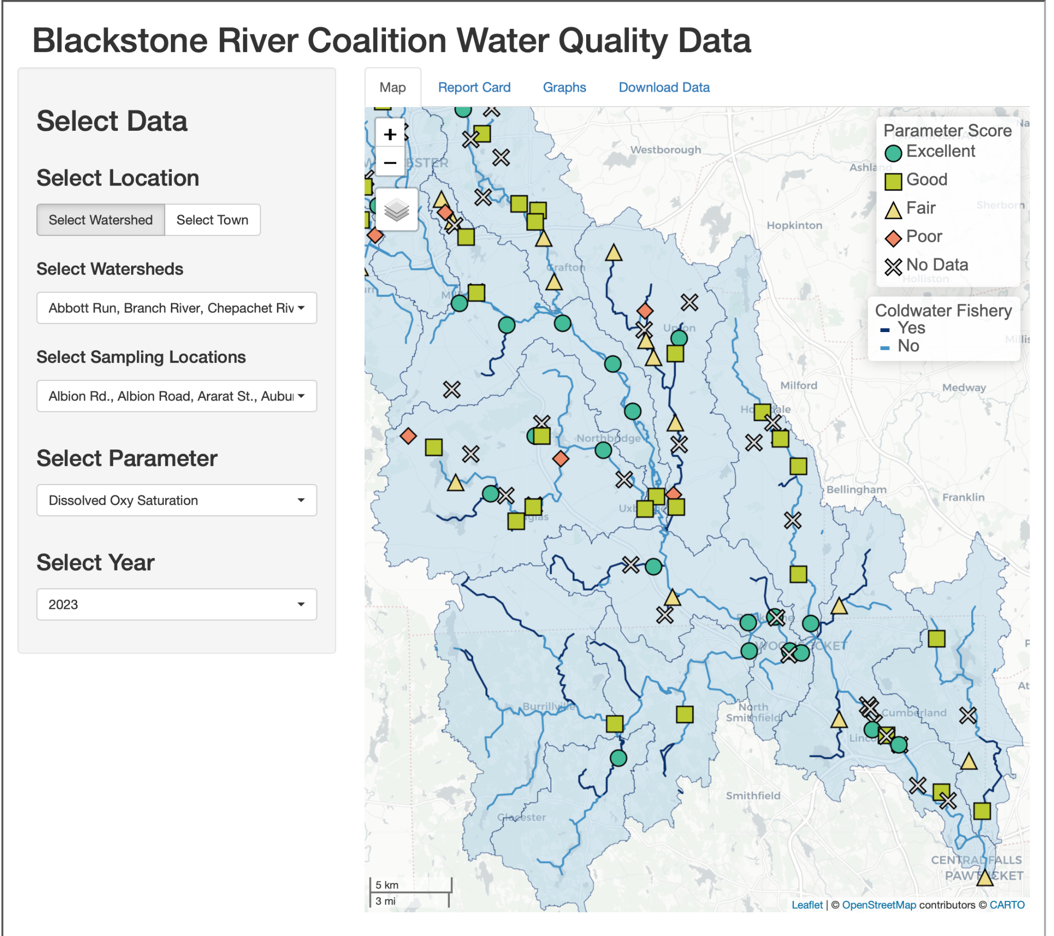
INITIAL SOLUTION: BRCMAP 2
Address a goal from the “Blackstone Needs Assessment”
Enables easy data sharing
  Interested people and organizations can easily select sites and parameters
  Download the data
The map makes our data easily accessible to interested folks.
Notes:
I can mention why we need this map (goal in the Blackstone Needs Assessment Report, share data with universities, residents, municipalities) Example of 604 b project using the data to develop a watershed based plan

Slide 8
NEW SOLUTION: WQDASHBOARD
WQdashboard is the successor to BRCmap. It was redesigned as a template that can be used by any organization.
Key Changes
Accepts multiple data formats
Dynamic, robust code adjusts to available data
  Example: If both surface and midwater is provided, then data can be filtered by depth
Ongoing support and maintenance by NBEP

Slide 9
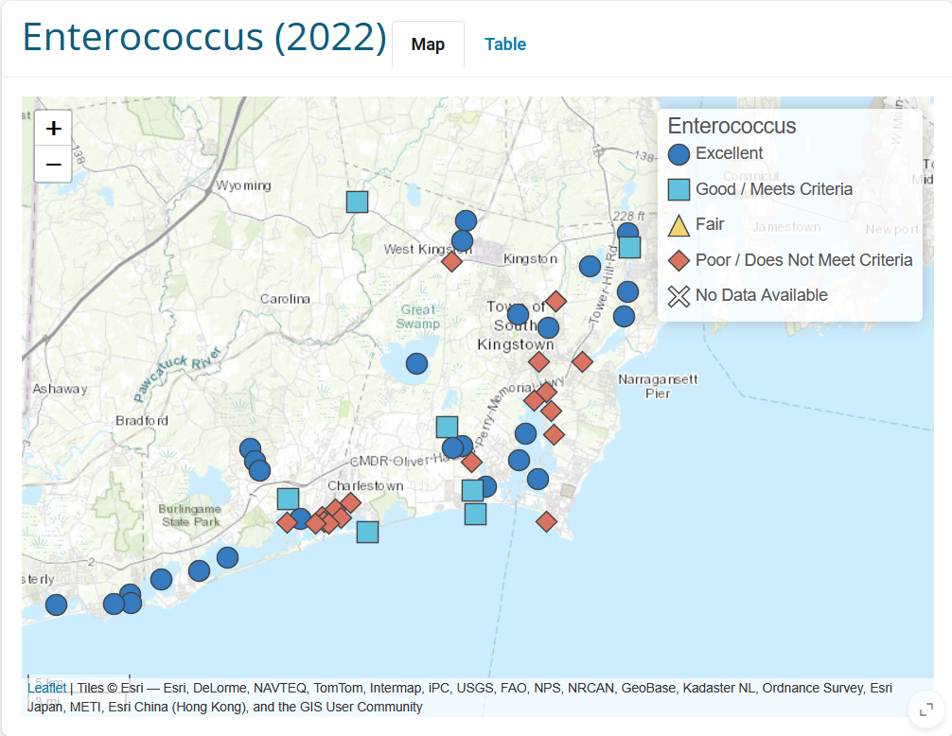
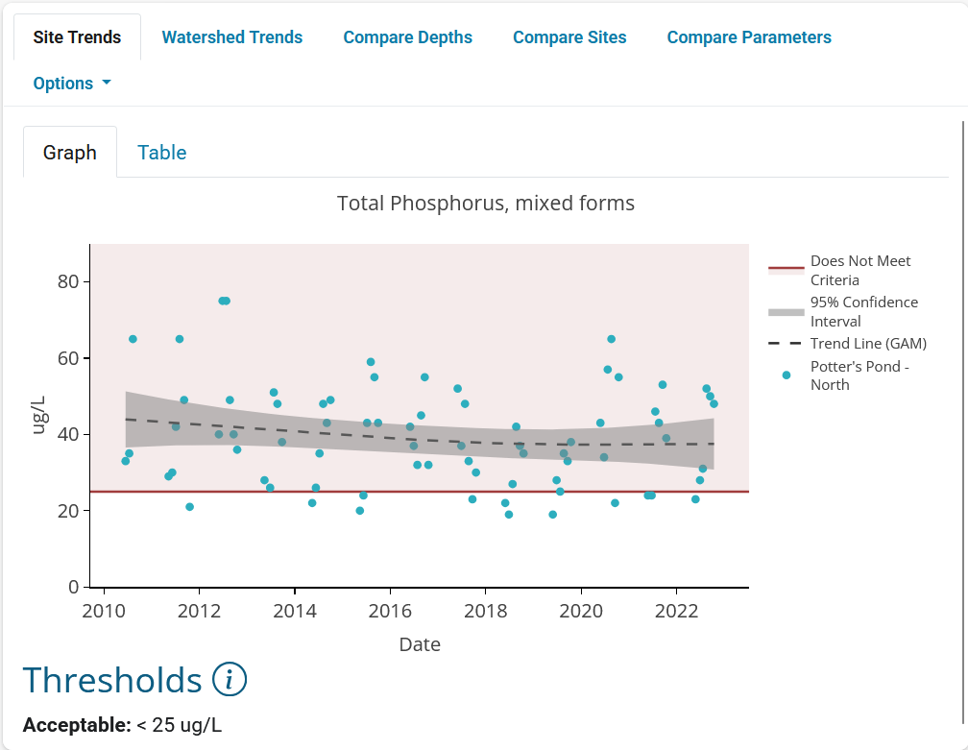
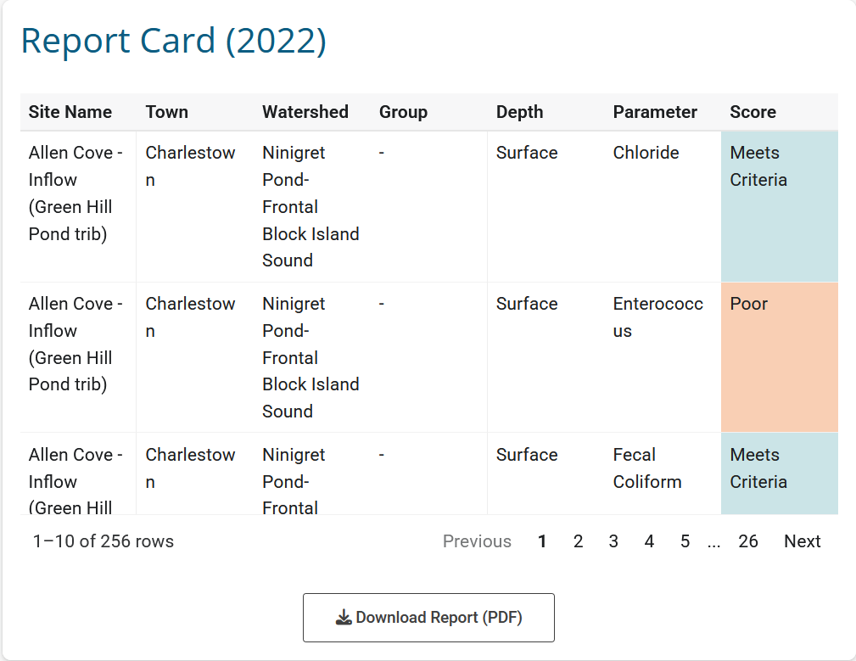
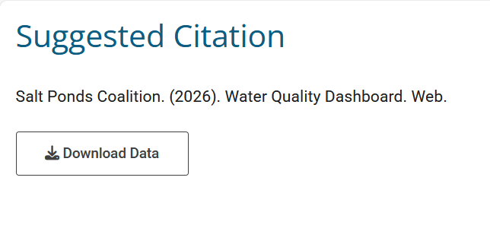
NEW SOLUTION: WQDASHBOARD 2

Slide 10

DEMO: WQDASHBOARD
Photo by Ayla Fox

Slide 11
DEMO LINK
https://nbep.shinyapps.io/wqdashboard

Slide 12
TOOLS
Mandatory
R https://cran.rstudio.com/
RStudio https://posit.co/download/rstudio-desktop/
Optional
GitHub https://github.com/
You do not need to know how to code!

Slide 13
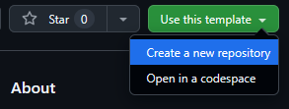
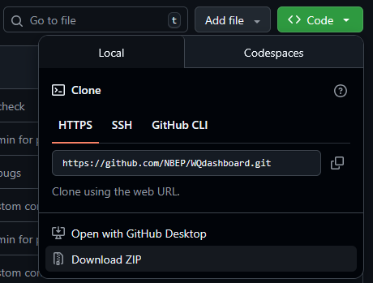
STEP 1: DOWNLOAD WQDASHBOARD
Download code here:
https://github.com/NBEP/WQdashboard
Option 1
Create a repository
Requires GitHub account
Provides version control, easier collaboration/troubleshooting
Option 2
Download ZIP file
Does not require GitHub account

Slide 14
STEP 2: UPLOAD DATA
Mandatory Files
1. Site metadata
2. Results data
Optional Files
1. Threshold metadata
Accepted Formats
WQdashboard
MassWateR
WQX
RI DEM
URI Watershed Watch
Blackstone River Coalition
Friends of Casco Bay
Maine DEP
Custom Format (see next slide)
WQdashboard will check for formatting errors but not data errors

Slide 15
STEP 2: UPLOAD DATA 2
WQdashboard has built in tools to include data from unsupported (eg “custom”) formats
Requirements
Data must be long (1 parameter per row), not wide (1 parameter per column)
Need to fill out 2-6 lookup tables with column and variable names
  Easy to edit CSV files
  Only needs to be done once!
Long Data
Site | Date | Parameter | Result
001 | 3/5/2026 | DO | 8
001 | 3/5/2026 | Nitrate | 10
001 | 3/5/2026 | pH | 7
Wide Data
Site | Date | DO | Nitrate | pH
001 | 3/5/2026 | 8 | 10 | 7

Slide 16
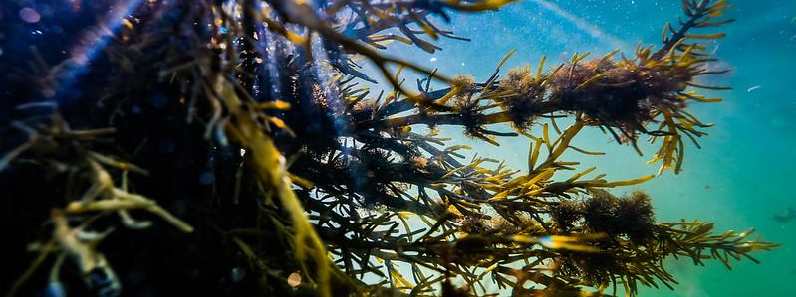
DEMO: UPLOADING DATA
Photo by Ayla Fox

Slide 17
DEMO SUMMARY
Install R, Rstudio
Download WQdashboard from github, unzip folder
Save site metadata, result data to folder “data-raw” as CSV files
Open WQdashboard.Rproj
In lower right panel, select folder “data-raw”
Open 00_install.R and follow instructions there
      Steps 2, 4, and 6 are optional
      Steps 0-4 only need to be run once
      About.qmd and Download.qmd can be edited in visual mode (upper left corner)

Slide 18
STEP 3: HOSTING
shinyapps.io offers up to 25 hours/month of free hosting for R Shiny apps
Need to make an account
Paid options if you expect more site traffic
Pros: cheap, easy to set up
Cons: site runs a bit slow, need to refresh page after ~15 minutes inactivity
Other options include Posit Connect, Shiny Server
R Shiny apps can be hosted as independent websites or embedded in an existing website

Slide 19
RESOURCES
Interested in using WQdashboard? Contact Mariel Sorlien at msorlien@nbep.org for technical support
Links
Code https://www.github.com/NBEP/WQdashboard
Demo https://nbep.shinyapps.io/wqdashboard

